Slide 1
BizTalk Service Authorization
Riziv-Inami

Slide 2
Agenda
Service Router
Service Authorization

Slide 3
Service Router

Slide 4
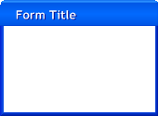





Point to Point connections
Backend
No overview
Hard to manage
Who connects to what?
No central point to handle common functionality like:
Security
Logging
Auditing
…
Backend
Backend

Slide 5
Service routing (WCFServiceHost)
Backend
tcp
wsHttp (Win)
WCFServiceHost
http
Backend
netTcp (Cert)
https
No point to point
One place to figure out who is calling who
Central place for common logic (security, logging, auditing)
Abstraction layer for service addresses (clients to not have to know the backend addresses
Backend
Notes:
Message are routed based on SOAP actions
SOAP actions are promoted

Slide 6
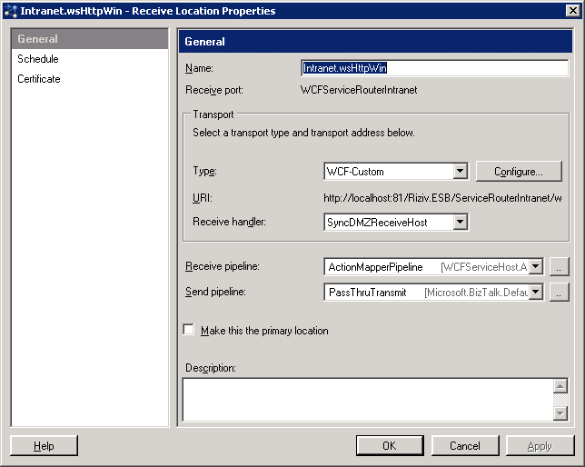
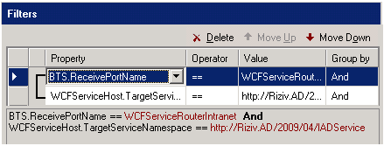
How to use the WCF Service Host
One on-ramp per protocol/security combination
On-ramp = receive location in BTS (hosted in process)
Router functionality implemented in the ActionMapperPipeline (and subscriptions)
One send port per backend webservice
Subscriptions are realized by using the SOAP action (promoted by the ActionMapperPipeline)

Slide 7
Service authorization

Slide 8



Authorization the old/static way 1/2
Service
Implicit:
Explicit:
AD

Slide 9
Authorization the old/static way 2/2
Coupling between code and authorization logic
Redeploy if groups/authorization logic changes
Authorization to services can not be managed in one central point
Very poor overview of who has access to what

Slide 10


ServiceRolesAndCertAuthoriation
Backend
Access Denied!
wsHttp (Win)
WCFServiceHost
AUTHZ
Backend
netTcp (Cert)
Backend

Slide 11
ServiceRolesAndCertAuthorization advantages
Basic Authorization is possible without doing anything in the backend service
On service level
Using AD Roles
Using Certificates
More security types can be added later… (eg claims)
On operation level
Using AD Roles
Using Certificates
More security types can be added later… (eg claims)
Authorization is managed in one central point
Good overview of service access rights
Authorization is done purely in configuration (no rebuilds, no redeployments)

Slide 12
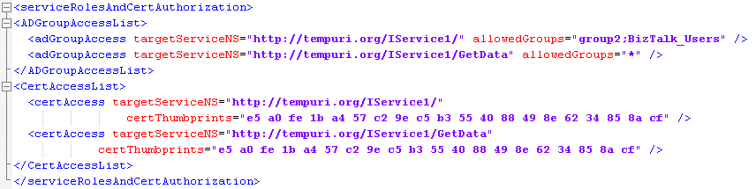
ServiceRolesAndCertAuthoriation configuration
adGroupAccess when using Windows (AD) security
targetServiceNS: specify the service/operation to secure (SOAP action)
allowedGroups : groups that have access to the service/operation
certAccess when using Certificates
targetServiceNS: specify the service/operation to secure (SOAP action)
certThumbprints: certificates (thumbprints) that have access to the service/operation

Slide 13

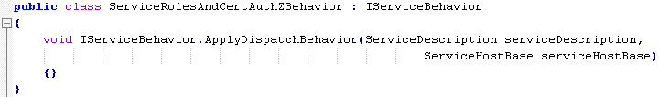
Implementation
WCF Extensibility
Inherit from ServiceAuthorizationManager
Implement the authorization logic in the CheckAccess() method.
Implement a custom ServiceBehavior (IServiceBehavior)
In the ApplyDispatchBehavior method, replace the default ServiceAuthorizationManager with the custom one you implemented.
Inherit from BehaviorExtensionElement
This class is necessary to control the configuration of the custom behavior.

Slide 14

Forward the original caller
Backend
John
wsHttp (Win)
WCFServiceHost
AUTHZ
ServiceAcc
Backend
netTcp (Cert)
John
Backend
ASPNET

Slide 15
Forward the original caller
A custom message inspector adds the original caller to the SOAP header of the incoming message. BizTalk will copy this headers to a context property for later use
Use custom send pipeline component
No configuration is needed on this component
This custom pipeline component adds the original caller to the SOAP header of the outgoing message.
Use SSL to the backend service!
ForwardOriginalCallerPipeline is also available
Only contains the ForwardOriginalCallerPipelineComponent

Slide 16
Questions?
?

Slide 17

Frontend
Backend
STS

